Slide 1
Student Athlete AER Redesign
Alice Levine
Sasha Fierce
TechEdit
Notes:
Notes to self: Hand out this PowerPoint presentation as a document so audience can follow along.
Content: Thank you for accepting our proposal to redesign the Athlete Academic Expectations and Requirements (AAER) document. We have conducted an analysis of the current document and revised it with the information we’ve gathered. Our usability studies show that our new prototype makes the information easier to access and in a more timely manner.

Slide 2
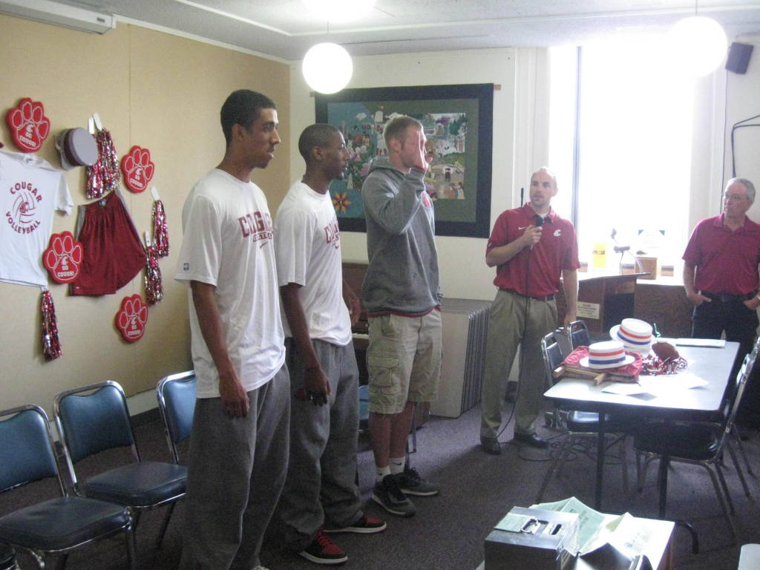
Background
Students are constantly handed papers and documents the are told to read
Student athletes have very tight schedules
No time to read lengthy document
A staple packet of paper does not seem as important as a bound manual
Notes:
The AAER has some problems. It’s difficult to access. It’s not laid out very well. And with student’s busy schedules, especially student athletes, they just don’t take the time to read through all the information.

Slide 3
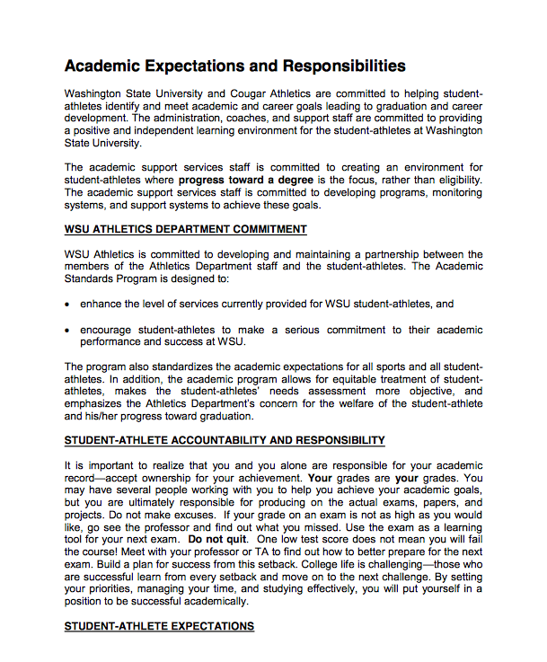
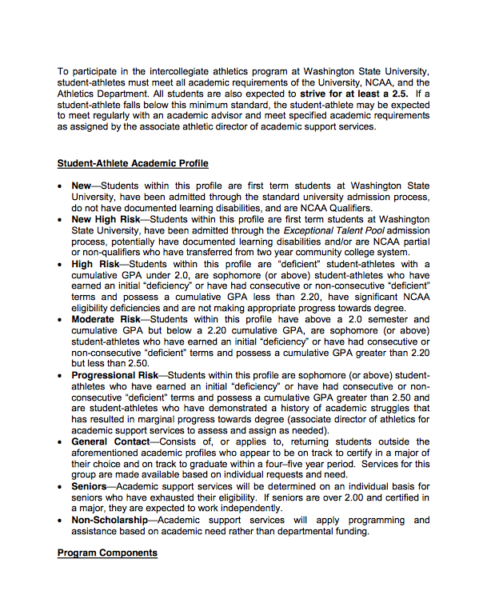
Current Document
No contrast
Boring
Lengthy
Lacks typography
Unprofessional
No Table of
Contents
Notes:
Here is an example of the current document. As you can clearly see, it’s lengthy and doesn’t contain any visual elements. It’s boring! Yuck.
Notes to self: Nailed it!!!

Slide 4
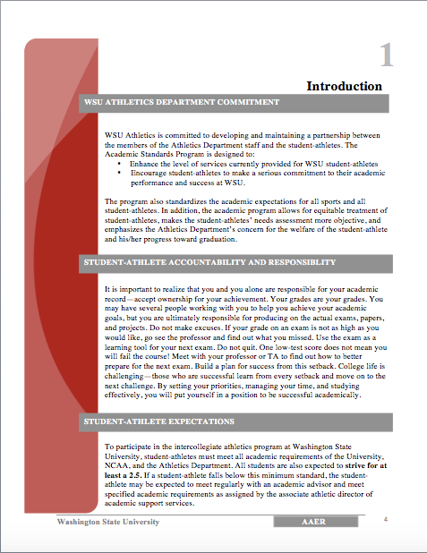
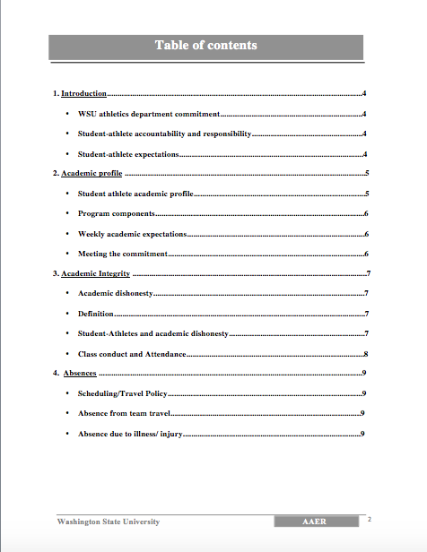
Our Design
Inviting and Professional
Repetitive
Contrasting
Organized TOC
Team Spirited
Typographic
Notes:
Here is our new design. As you can clearly see it’s organized and more inviting.
Note to Self: Go through the features of the new document.

Slide 5
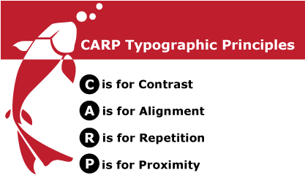
Redesign
Wanted to make it more concise/easier to read
Used the four basic principles (C.A.R.P) from Robin William’s NDDB.
Contrast-Different Elements
Alignment-Nothing placed arbitrarily
Repetition-Repeat Visual elements
Proximity-Group like information
Notes:
We wanted to make the document more concise and easier to read so we used Robin William’s basic design principals. They are contrast, alignment, repetition, and also we use proximity.
Note to Self: Explain the 4 principals.

Slide 6
Usability Test
Jakob Nielsen’s five quality components of usability
Learnability: How easy is it for users to accomplish basic tasks the first time they encounter the design?
Efficiency: Once users have learned the design, how quickly can they perform tasks?
Memorability: When users return to the design after a period of not using it, how easily can they reestablish proficiency?
Errors: How many errors do users make, how severe are these errors, and how easily can they recover from the errors?
Satisfaction: How pleasant is it to use the design?
Notes:
We conducted a usablity test using Robin William’s five components of usablitiy.
Note to Self: Read through the components listed on this slide.

Slide 7
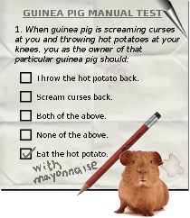
Usability test: set up
Four students tested
Actions taken to minimize sources of error in testing
Satisfaction scores between 1-5, 5 being the highest
Notes:
We tested the old document and well as the new prototype. During our usability test, we asked students to answer simple questions about the AAER report. Then after they were down taking the test, we asked them to rank their satisfaction of the document from a scale of one to ten.

Slide 8
Usability Results
Time(min) | Student takes test using original document first
 | Student 1 |  |  | Student 2
 | Learnability | Efficiency | Satisfaction | Learnability | Efficiency | Satisfaction
Original design | 3.46 | 3.09 | 3 | 4.15 | 3.39 | 4
Our design | 2.24 | 2.06 | 5 | 2.45 | 2.36 | 5
% change | 35.21% decrease | 33.34% decrease | 66.67% increase | 40.96% decrease | 30.38% decrease | 25% increase
Time(min) | Student takes test using redesigned document first
 | Student 3 |  |  | Student 4
 | Learnability | Efficiency | Satisfaction | Learnability | Efficiency | Satisfaction
Original design | 3.05 | 2.47 | 2 | 3.55 | 3.19 | 2
Our design | 2.31 | 2.01 | 5 | 2.48 | 2.41 | 4
% change | 24.26% decrease | 18.62% decrease | 150% increase | 30.14% decrease | 24.45% decrease | 100% increase
Notes:
Go through the results of the test.

Slide 9
Usability Results
According to our Usability Tests, we:
Increased the learnability of the document by 28%
The document now has better efficiency (26%)
We also made the satisfaction much better. We increased it by 148%
Notes:
Note to self: Yay, the presentation is over. Did we go HAM on that or what?

