Slide 1
Charlotte Perkins Gilman’s “The Yellow Wallpaper”
The Rest Cure

Slide 2
Nineteenth-century Medical Ideas about Women’s Health
S. Weir Mitchell: “[Before age 17] a very steady use of the brain is in many dangerous to health and to every probability of future womanly usefulness.”
P. Moebius. “If we wish woman to fulfill the task of motherhood fully she cannot possess a masculine brain. . . . [H]er material organs would suffer and we should have before us a repulsive and useless hybrid.”

Slide 3
Views, continued
John Harvey Kellogg: “The practice of novel reading is one of the greatest causes of uterine disease in young women.”
Notes:
Image source: http://americangallery.wordpress.com/category/chadwick-william/

Slide 4
The “Rest Cure” Diet
A typical daily menu was enormous, including “a light breakfast. . . a mutton chop as a midday dinner. . . bread and butter thrice a day,” and “three or four pints of milk, which are given at and after meals.”
To this might be added iron supplements, doses of strychnine, arsenic, and cod liver oil, as well as “one pound of beef, in the form of raw soup. This is made by chopping up one pound of raw beef, placing it in a bottle with one pint of water and five drops of strong chlorohydric acid” (Fat and Blood 78-9).
Notes:
Source: Anne Stiles, http://www.branchcollective.org/?ps_articles=anne-stiles-the-rest-cure-1873-1925

Slide 5
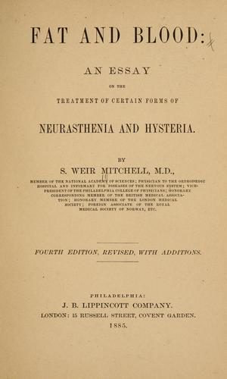
S. Weir Mitchell, from Fat and Blood, And How to Make Them (1877)
The rest I like for them is not at all their notion of rest. To lie abed half the day, and sew a little and read a little, and be interesting and excite sympathy, is all very well, but when they are bidden to stay in bed a month, and neither to read, write nor sew. . . then rest becomes for some women a rather bitter medicine.
The patient remains in bed from six weeks to two months.
I do not permit the patient to sit up or to sew or write or read. The only action allowed is that needed to clean the teeth.
In some cases I have not permitted the patient to turn over without aid.
Notes:
http://openlibrary.org/works/OL15355728W/Fat_and_blood

Slide 6
Gilman on Weir’s Treatment
“I was put to bed and kept there. I was fed, bathed, rubbed, and responded with the vigorous body of twenty-six. As far as he could see there was nothing the matter with me.”
His prescription: “Live as domestic a life as possible. Have your child with you all the time. Lie down an hour after each meal. Have but two hours’ intellectual life a day. And never touch pen, brush, or pencil as long as you live.”
Question for the class: How would you like to be the recipient of such a treatment?

Slide 7
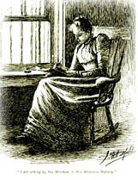
“The Yellow Wallpaper”
Published in The New England Magazine in 1892.
This illustration is from the beginning of the story.

Slide 8
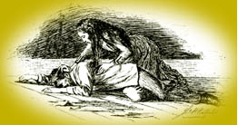
End of the Story
Question: How has she changed?
Notes:
http://public.wsu.edu/~campbelld/amlit/gilman.html

Slide 9
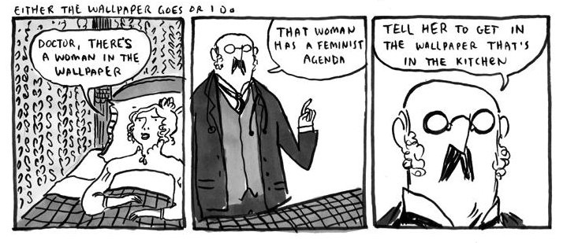
“Either the wallpaper goes or I do”
Notes:
From Hark! A Vagrant. http://www.harkavagrant.com/index.php?id=292

