Slide 1
Three Poems and Three Wars

Slide 2
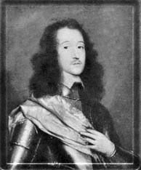
Richard Lovelace, 1618-c.1657
English Civil War (1642-1651)
Parliamentarians (“Roundheads”) under Oliver Cromwell versus Royalists
Execution of Charles I on 30 January 1649
Notes:
http://www.luminarium.org/sevenlit/lovelace/

Slide 3
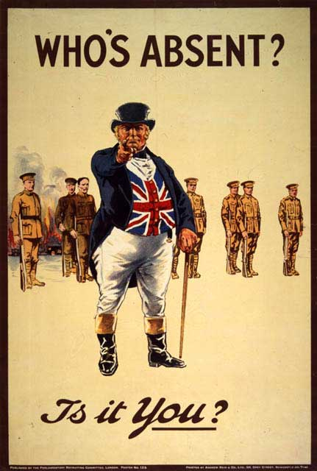
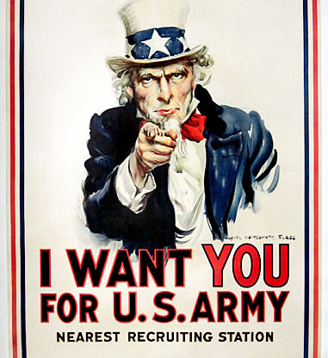
World War I 28 July 1914 to 11 November 1918

Slide 4
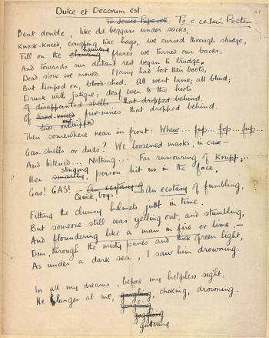
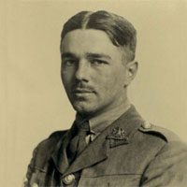
Wilfred Owen, 18 March 1893 – 4 November 1918
Notes:
http://www.oucs.ox.ac.uk/ww1lit/collections/owen

Slide 5
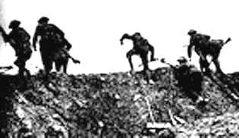
Owen, continued
“Dulce et Decorum Est” written between 8 October 1917 - March 1918.
Letter after the Battle of the Somme, July-November 1916: “After that we came to where the trenches had been blown flat out and had to go over the top. It was of course dark, too dark, and the ground was not mud, not sloppy mud, but an octopus of sucking clay, three, four, and five feet deep, relieved only by craters full of water . . .”
Math question: Owen died on 4 November 1918. How long did the war last after his death?

Slide 6
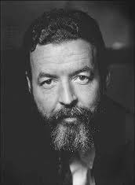
Randall Jarrell (1914-1965)
Served in U.S. Army Air Force during World War II (1941-1945)
Later Poet Laureate Consultant in Poetry to the Library of Congress

Slide 7
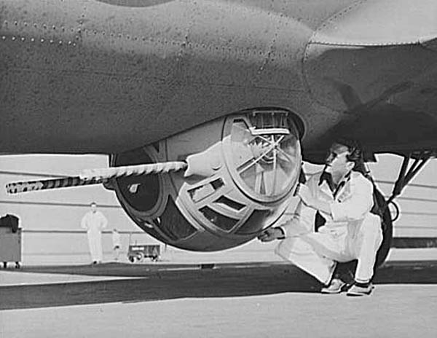
Ball Turret

Slide 8
Terms
Caesura: A short but definite pause used for effect within a line of poetry.
End-stopped rhyme: A line ending in a full pause, usually indicated with a period or semicolon.
Enjambment: A line having no end punctuation but running over to the next line.
Assonance: internal rhymes, or matching vowel sounds within words: “white eyes writhing”

Slide 9
Questions
As we read these poems, what clues do you see to the era in which they were written?
Are there specialized terms that you had to look up?
How does each of these poems convey a strong sense of the speaker, the “I” or “we” of the poem?
Bear in mind the terms we’ve already discussed: repetition, contrast, alliteration, rhyme, parallelism, and so on.

Slide 10
Exercise (5 minutes)
Talk to the person next to you and, choosing one of the poems, discuss those questions.
How does each of these poems convey a strong sense of the speaker, the “I” or “we” of the poem?
What technical features did you notice in the poem, and, most important, what was their effect? (Examples: sensory images, repetition, contrast, alliteration, rhyme, parallelism, caesura, enjambment, and so on).

