Slide 1
Business & Technology
Handling Information

Slide 2
Welcome to the Information Age
Information Age: The period that began in 1957, in which the majority of workers are involved in the creation, distribution, and application of information.
Knowledge Workers: Workers involved in the creation, distribution, and application of information.

Slide 3
The Information Age
Businesses depend on information technology to get their work done.
E-workforce is when people work with computers while doing business.
According to the Bureau of Labor Statistics more than 70 million people use computers daily.

Slide 4
The Information Age
Information technology provides the means to rethink/recreate/reengineer conventional business processes.
Reengineering: The reshaping of business processes to remove barriers that prohibit an organization from providing better products and services and to help the organization capitalize on its strengths.
Business Processes: Collections of activities, often spanning several departments, that take one or more kinds of input and create a result that is of value to a company’s customers.

Slide 5
Why Do People Need Information?
Individuals - Entertainment and enlightenment
Businesses - Decision making, problem solving and control

Slide 6
The Information Age
Success in business is largely determined by the effectiveness with which information technology is used.
Information technology is embedded in many products and services.

Slide 7
The Information Age
The ease of doing business online has created a boom in new businesses, or start-ups. This type of business is called a virtual business.
Virtualization: Accessibility through technology that allows business to be conducted independent of location.

Slide 8
E-Commerce
Electronic commerce, or e-commerce, has made it possible for businesses to directly reach customers anywhere in the world.
The main activity of e-commerce is buying and selling goods and services.

Slide 9
Cloud Computing
Cloud computing is the use of computing resources (hardware and software) that are delivered as a service over a network (typically the Internet) in a timely (near on instant), on-demand manner.
The name comes from the use of a cloud-shaped symbol as an abstraction for the complex infrastructure it contains in system diagrams. Cloud computing entrusts remote services with a user's data, software and computation.

Slide 10
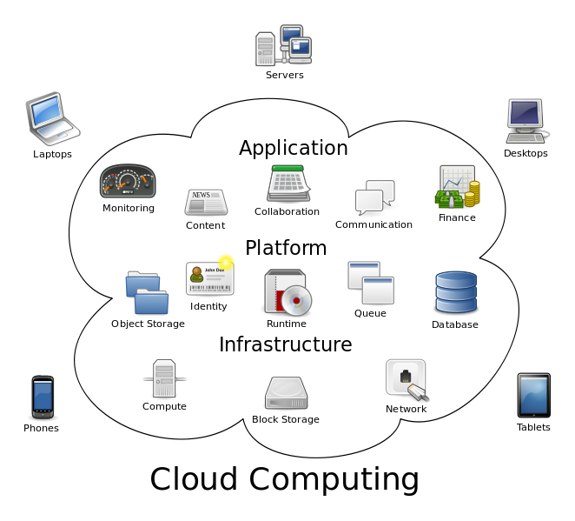
Cloud Computing

Slide 11
What is Information Technology?
A term used to refer to a wide variety of items and abilities used in the creation, storage, and dispersal of data and information. Its three main components are computers, communications networks, and know-how.

Slide 12
The Knowledge Pyramid
Also know as the DIKW hierarchy:
Data: Raw facts, figures, and details.
Information: An organized, meaningful, and useful interpretation of data.
Knowledge: An awareness and understanding of a set of information and how that information can be put to the best use.
Wisdom: Evaluated understanding.

Slide 13
Characteristics of Useful Information
Relevant. It reduces uncertainty by helping you predict what will happen or confirm what already has happened.
Reliable. It’s dependable, i.e., free from error or bias and faithfully portrays events and activities.
Complete. It doesn’t leave out anything that’s important.
Current. You get it in time to make your decision.
Understandable. It’s presented in a manner you can comprehend and use.
Verifiable. The nature of the information is such that different people would tend to produce the same result.
Accessible. You can get to it when you need it and in a format you can use.

Slide 14
DANGER! Info. Glut
When you get more information than you can effectively assimilate, you suffer from information overload.
When you’ve reached the overload point, the quality of decisions declines while the costs of producing the information increases.

Slide 15
Information Systems / Technology
Data Processing - Early name for business technology used to support existing processes and primarily to improve the flow of financial information
Information Systems (IS) – Combination of Information technology and business processes that are designed to help people collect, create and distribute useful information
Information Technology (IT) - Hardware, software and telecommunications network technologies used to support business processes

Slide 16
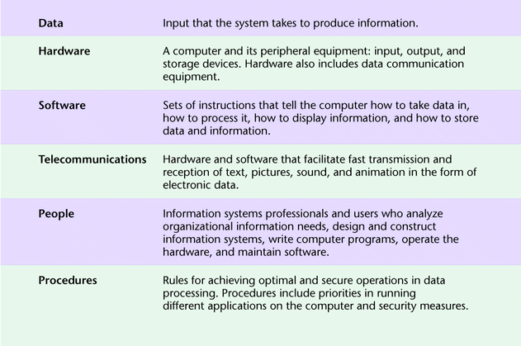
Components of an Information System

Slide 17
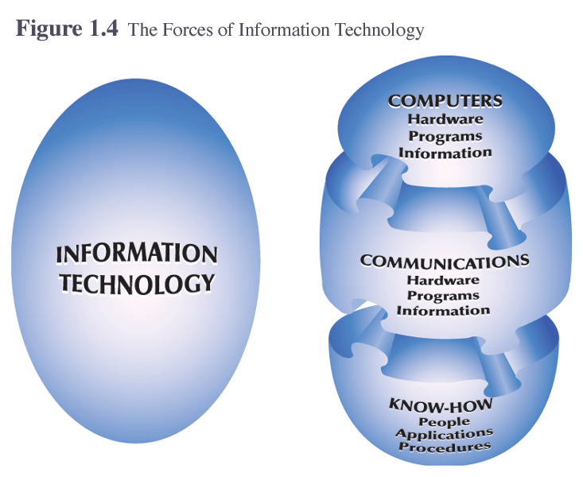
What is Information Technology?

Slide 18
IT vs. IS
INFORMATION TECHNOLOGY
Hardware
Software
Databases
Networks
Other related components
are used to build
INFORMATION SYSTEMS
Payroll System
Inventory System
Marketing System
Customer Service System

Slide 19
Information Systems: Turn Data into Information
Data
Information
Raw material
Unformatted information
Generally has no context
Processed material
Formatted information
Data given context
Ticket sales of a band on tour
Examples
Sales report by region and venue…tells us which venue is the most profitable

Slide 20
People: Three Competencies of IS Professionals
Technical
Knowledge of hardware, software, networking, and security.
Most IS professionals are not deep technical experts but can direct/manage others with the required technical skills

Slide 21
People: Three Competencies of IS Professionals
Business
Understand the nature of business including process, management, social, and communication domains
Unique skills over those with only technical skills

Slide 22
People: Three Competencies of IS Professionals
Systems
Knowledge of approaches and methods, also possess critical thinking and problem solving skills necessary to build and integrate large information systems
Unique skills over those with only technical or business skills

Slide 23
People: Three Competencies of IS Professionals
Careers in information systems require interpersonal, business, and technical skills and pay well.

Slide 24
Executive Roles in Information Systems
CEO
Chief Executive
Officer
COO
Chief Operations
Officer
CFO
Chief Financial
Officer
CIO
Chief Information
Officer
Manages IT Organization and Operations
Forecasts IT Needs from Business Strategy
Sets Direction for IT Architecture and Organization
Plans, Designs and Delivers IT throughout the firm

Slide 25
Database Technology
Database - an organized collection of logically related data
A collection of related data organized in a way that makes it valuable and useful
Allows organizations to retrieve, store, and analyze information easily
Is vital to an organization’s success in running operations and making decisions
Data warehouse – an integrated set of related databases containing historical data that is used to support managerial decision-making

Slide 26
Organizational Use of Databases
Operational
Informational
Extract
Data
Department
Databases
Data
Warehouse
Stores day-to-day department transactions
Used primarily by departments
Extracted department transactions from many databases
Used for business analysis and data mining

Slide 27
Data Mining
Process of finding hidden patterns in data (often using data warehouses)
Is a technique companies use to analyze information to better understand their customers, products, markets, or any other phase of their business for which they have data
With data mining tools you can graphically drill down, sort or extract data based on certain conditions, perform a variety of statistical analysis

Slide 28
Networks
Client/Server Computing - Computing systems that allow personal computers (clients) to obtain needed information from databases in a central computer (the server).
Ex. web servers and a client with a browser
Internet – A network of networks, with no central computer. No one owns the Internet.
World Wide Web – a means of accessing, organizing, and moving through the information in the Internet

Slide 29
Intranets
A companywide network, closed to public access, that uses Internet-type technology
An internal, private network using Web technologies to securely transmit information within the organization.
This private internal Web limits viewing access to authorized users within the organization
Intranet Benefits
Improved information access to authorized users
Improved timeliness and accuracy of information
Global reach allowing employees access from anywhere
Cross-platform integration
Low cost deployment
Positive return on investment

Slide 30
Extranets
Semiprivate network that uses Internet technology and allows more than one company to access the same information
Extranets are secure networks that provide customers, suppliers, and employees with access to internal systems
Two or more Intranets
Extranet Benefits
Improves timeliness and accuracy of communications reducing errors and misunderstandings
Uses standard web protocols allowing disparate computing platforms to communicate without additional investments
Easy to use, requires little training
Used to automate transactions, reducing cost and cycle time
Can replace EDI for small to medium size firms

Slide 31
Internet Connectivity
Broadband Technology
Technology that offers users a continuous connection to the Internet and allows them to send and receive mammoth files that include voice, video, and data much faster than ever before
Internet Research User Frustration
After 1995, increases in personal and business traffic began congesting the network primarily used for research
Internet2
University Corporation for Advanced Internet Development (UCAID) was formed to lead the design and development of an private high-speed alternative to the public Internet. Runs more than 22,000 times faster and uses very-high-speed backbone network service (vBNS)

Slide 32
Software
Software
Programs that control the basic functions of computer hardware and let the user perform a specific task or operation. Software can be either proprietary or open-source.
Commercial
Software that is copyrighted and licensed
Ex. MS Office, Windows, SPSS
Shareware
Software that is copyrighted but distributed to potential customers free of charge
Ex. Mozilla Firefox
Freeware (public domain software)
Software that is not copyrighted and free for the taking

Slide 33
What is Computer Security?
Computer security involves providing appropriate levels of assurance of
Availability of computing services and data/information stored in computing systems
Confidentiality of data/information stored in computing systems
Integrity of computing systems and data/information stored therein
Auditability of usage of computing systems and access to data/information stored therein
Non-repudiability of transactions initiated by individuals and organizations

Slide 34
Security Threat: Viruses
A piece of programming code inserted into other programming to cause some unexpected and for the victim, usually undesirable event.
Programs that can attack a computer and/or a network and delete information, disable software, use up all system resources, etc.
Prevention Steps:
Install AntiVirus software
No Disk Sharing
Delete Suspicious Email Messages
Report Viruses

Slide 35
Security Threat: Cookies
A message passed to a Web browser from a Web server. Used by legitimate programs to store state and user information (such as registration data or user preferences)
Problems: can be used to track user activities
Prevention: browser settings, firewalls

Slide 36
Security Threat: Spyware
Any software that covertly gathers information about a user through an Internet connection without the users knowledge
Problems: uses memory resources, uses bandwidth, and can cause system instability
Prevention: Firewalls and anti-Spyware software

Slide 37
Not Just An IT Problem
Everyone who uses a computer needs to understand how to keep his or her computer and data secure.
10% of security safeguards are technical
90% of security safeguards rely on us – the user - to adhere to good computing practices

Slide 38
Major Solutions
Authentication--proving the identity of a person or system
Access control--limiting who and what can gain access to
Systems and their components
Network devices
Applications
Data
Encryption-- transforming data in a manner such that they cannot be meaningfully read because they are garbled
Auditing and monitoring

Slide 39
Ethical and Societal Issues
Consumer Privacy
Organizations collect (and sometimes sell) huge amounts of data on individuals.
Employee Privacy
IT supports remote monitoring of employees, violating privacy and creating stress.
Freedom of Speech
IT increases opportunities for pornography, hate speech, intellectual property crime, an d other intrusions; prevention may abridge free speech.

Slide 40
Ethical and Societal Issues
IT Professionalism
No mandatory or enforced code of ethics for IT professionals--unlike other professions.
Social Inequality
Less than 20% of the world’s population have ever used a PC; less than 3% have Internet access.

