Slide 1
1960s Film Revolution and the French New Wave
Background for Bonnie and Clyde

Slide 2
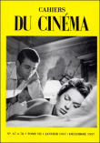
Film Background: French New Wave
Critics and theorists who published in Cahiers du Cinema and Arts
Protest against safe, cinematically polished, but inauthentic cinema—the “tradition of quality” cinema
Francois Truffaut, “A Certain Tendency of the French Cinema,” Cahiers du Cinema (1954) criticized the timidity of conventionally ambitious films.

Slide 3
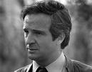
Truffaut in Arts, 1957
Directors make excuses by saying they have no control over content, but that is nothing but a crisis of courage and virility.
Excellent films can be made on low budgets.
There are no bad films, only mediocre directors.
Tomorrow’s films will be made by adventurers.
Notes:
Michele Marie, The French New Wave, p. 41

Slide 4
Auteur Theory
Term popularized in the U.S. by critic Andrew Sarris
(Truffaut): There is only one auteur (author) of a film and that is the director.
Certain directors—Jean Renoir, Max Ophuls—are auteurs with an identifiable vision but others are not.
“There are no works; there are only auteurs.”
Admiration for Howard Hawks (Scarface) and Alfred Hitchcock as precursors.
Andre Bazin: “technique that refers to metaphysics”—attention to style and mise-en-scene, not simply the scenario.

Slide 5
Characteristics and Techniques of “New Wave” Films
Disdain for conventional continuity editing
Use of jump cuts and modernist techniques of montage
The long take: sequences extended beyond conventional limits
Direct recording of sound
Improvisations added later by post-synchronization
Scripts were more personal and autobiographical, but the mise-en-scene was the place in the film where subjectivity really ruled.

Slide 6
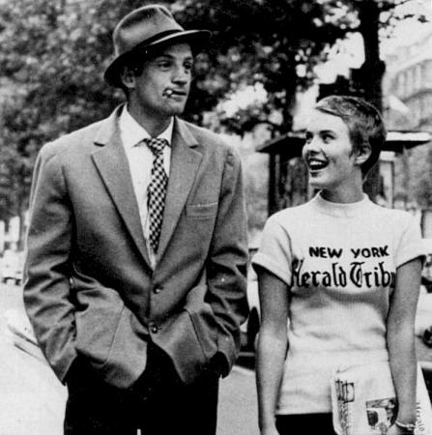
Practitioners
Claude Chabrol, The Cousins
Francois Truffaut, The 400 Blows, Jules and Jim (1962): tale of two free-spirited young men and a young woman
Eric Rohmer, Claire’s Knee and Six Moral Tales
Agnes Varda, Cleo from 5 to 7 (1962)
Jean-Luc Godard, Breathless (1960): story of a youthful antihero, a free-living petty thief, and his girlfriend, exemplifying individualism and resisting conventional bourgeois life

Slide 7
Truffaut on the New Wave’s Strengths and Limitations
“We believed that everything had to be simplified so we could work freely . . . Hence the quantity of New Wave pictures whose only common feature is a sum of rejection—the rejection of extras, of theatrical intrigue, costly sets, explanatory scenes; these films often have three or four characters and very little action. . . . The confusion lies in that the qualities of this new cinema—gracefulness, lightness, a sense of propriety, elegance, a quick pace—parallel its faults—frivolity, lack of thought, naïveté.”
Notes:
Marie, p. 101

Slide 8
American Movie Genres of the 1960s
Biblical epics or epics set in antiquity (King of Kings, 1961; Cleopatra, 1963)
Westerns, especially westerns that revised patriotic accounts of U.S. history or commented indirectly on the Vietnam war: How the West Was Won (1962) and The Alamo (1960) versus Little Big Man (1970).
“Adult” sex comedies (Rock Hudson and Doris Day in Pillow Talk, 1959; Lover Come Back, 1961)
Teen exploitation pictures (beach movies such as Beach Blanket Bingo, horror films)
Big-budget musicals that mostly tanked at the box office: Hello, Dolly; Star!; On a Clear Day You Can See Forever

Slide 9
Movie genres, continued
Social problem melodramas on race, often starring Sidney Poitier: In the Heat of the Night (1967); Guess Who’s Coming to Dinner? (1967)
Science fiction: 2001, A Space Odyssey (1968); Planet of the Apes (1968)
“Youth cult” films: Easy Rider (1969), Five Easy Pieces (1970), Alice’s Restaurant (1969), The King of Marvin Gardens (1972), Bonnie and Clyde (1967)
  Critique of dominant culture and authority figures
  Celebrated freedom, individualism, nonconformity, and resistance to authority
  Promoted authenticity of experience as a goal more important than making money or following the usual definitions of success.
Revival of African American films (no more “race movies”)
  “Blaxploitation” films (Shaft, 1971)
  Sweet Sweetback’s Baadassss Song (1971)

Slide 10
Class Suggestions
What other issues or films do you associate with the 1960s?
American Graffiti: cars, teens looking for escape from small town
Classic westerns: Butch Cassidy, Midnight Cowboy, Sergio Leone Westerns, The Wild Bunch
Dr. Strangelove
Spy movie: Dr. No, Goldfinger, Pink Panther
Black Sunday—groundbreaking horror film

Slide 11
The Tenant, Rosemary’s Baby
Psycho

